Slide 1
INTERFACE DESIGN
Weng Yew 143297M
Gabriel Wong 143476L
Rayson Poh 140750F
Notes:
DM2243 INTERFACE DESIGN & PROGRAMMING ASSIGNMENT 01
DONE BY THAM WENG YEW (143297M) AND GABRIEL WONG (143476L)

Slide 2
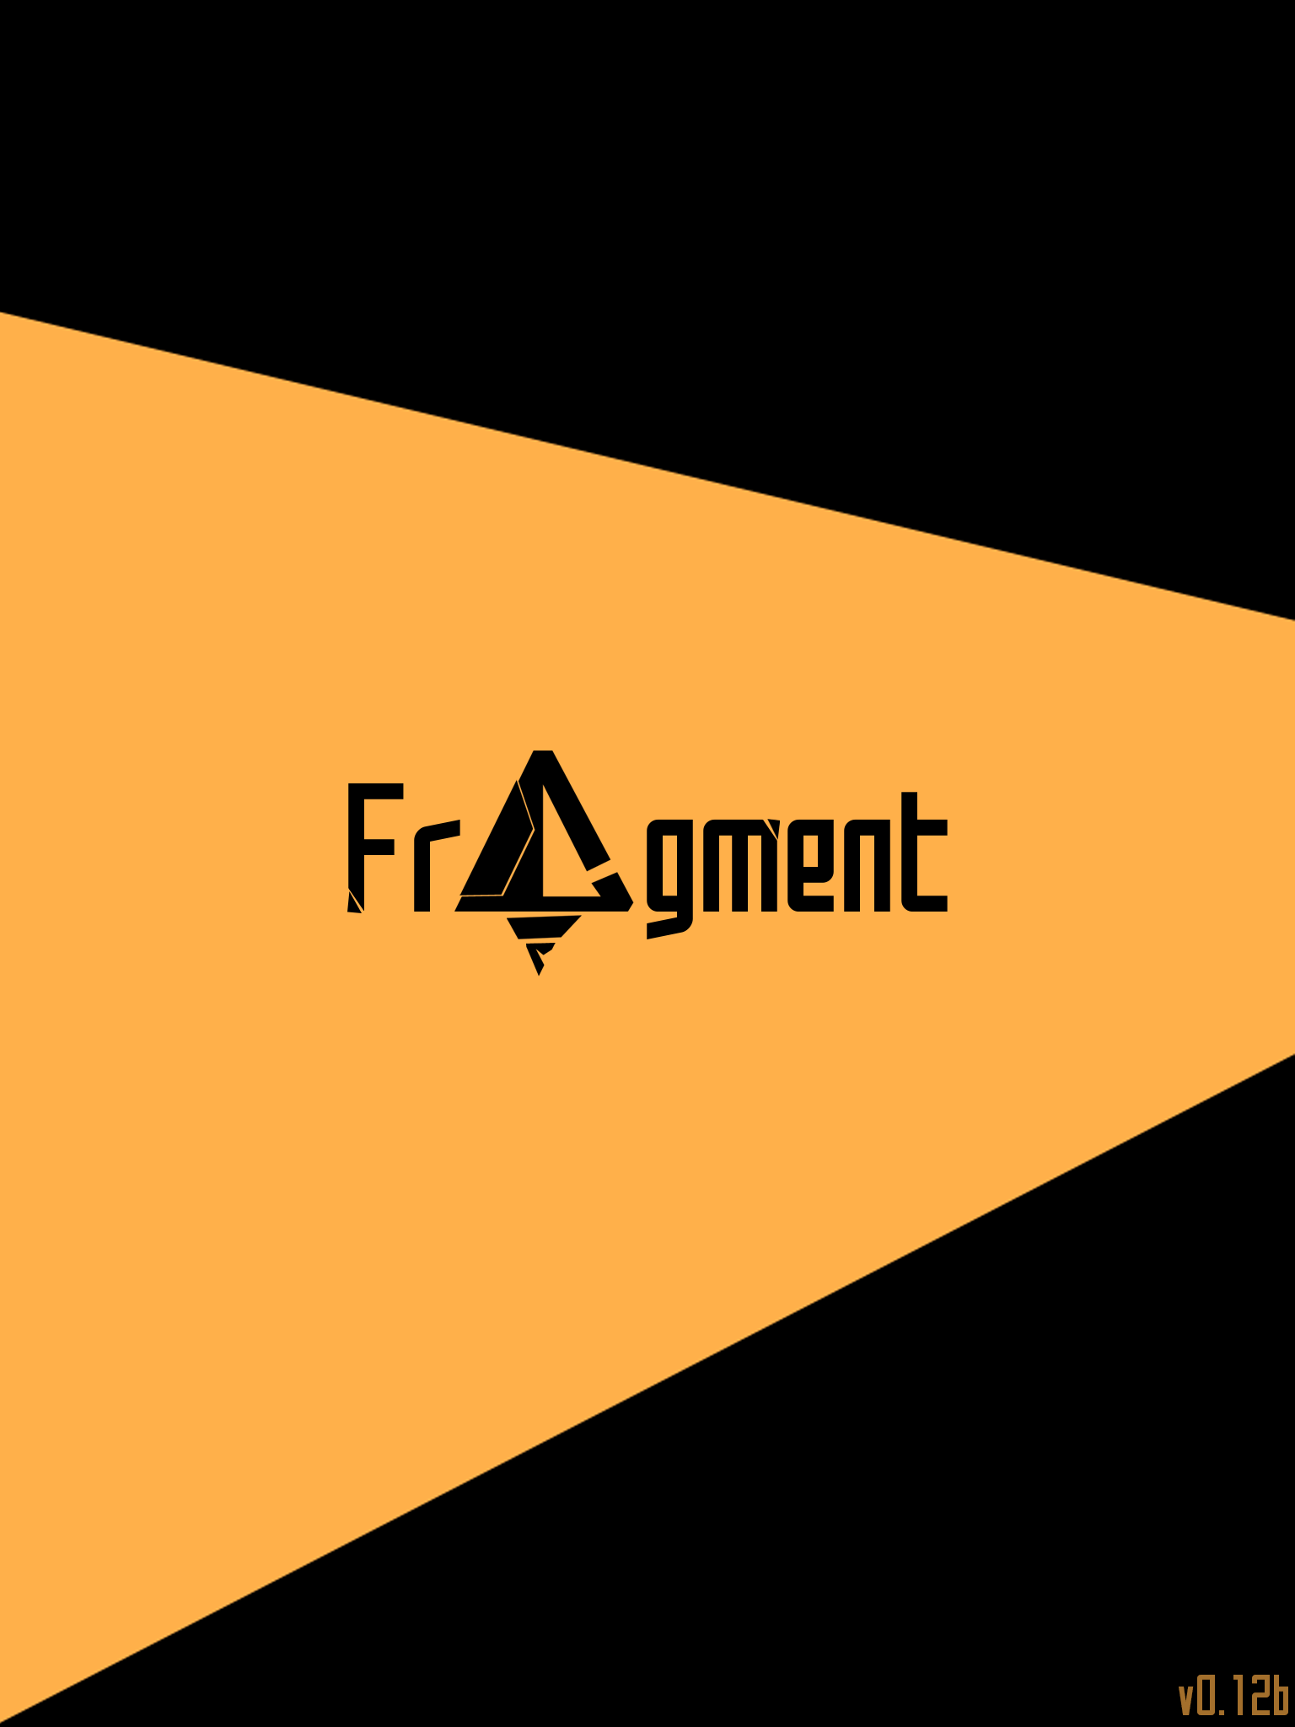
Splash
Screen
Notes:
SPLASH SCREEN WILL SWITCH TO MAIN MENU AUTOMATICALLY AFTER 3 SECONDS.
IF USER TAPS ON THE SCREEN, WILL SWITCH TO MAIN MENU IMMEDIATELY.
GAME LOGO IN MIDDLE- MOST OBVIOUS
GAME VERSION IN BOTTOM RIGHT- LESS OBVIOUS
DESIGNED BY GABRIEL.
Unity example done by Rayson

Slide 3
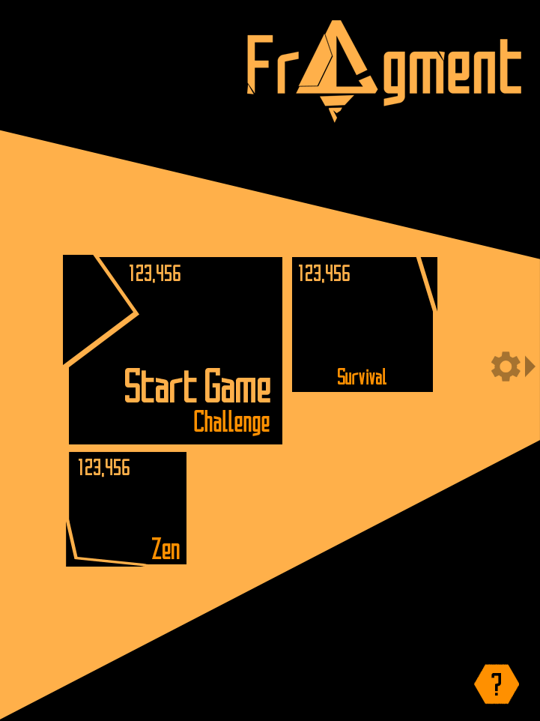
Main Menu
Notes:
SIZE OF THE BUTTON IS BASED ON WHAT WE THINK THE USER IS MORE LIKELY TO CLICK ON.
CHALLENGE IS THE MAIN MODE OF GAMEPLAY- BUTTON IS BIGGEST, WITH THE WORD ‘START GAME’ TO CLARIFY FUNCTION.
TAPPING ON CHALLENGE BRINGS YOU TO CHALLENGE SELECT
TAPPING ON ZEN STARTS ZEN GAMEPLAY
TAPPING ON SURVIVAL STARTS SURVIVAL GAMEPLAY
HIGH SCORE WILL BE SHOWN FOR SURVIVAL/ZEN ON THE TOP LEFT OF THE TILE.
TAP ON HEXAGON ‘?’ IN BOTTOM RIGHT TO SHOW HELP POP UP.
SWIPE TO THE LEFT/TAP ON SETTINGS ICON TO GO TO OPTIONS PAGE. [SLIDE 5]
DESIGNED BY WENGYEW.
Unity example done by Rayson

Slide 4
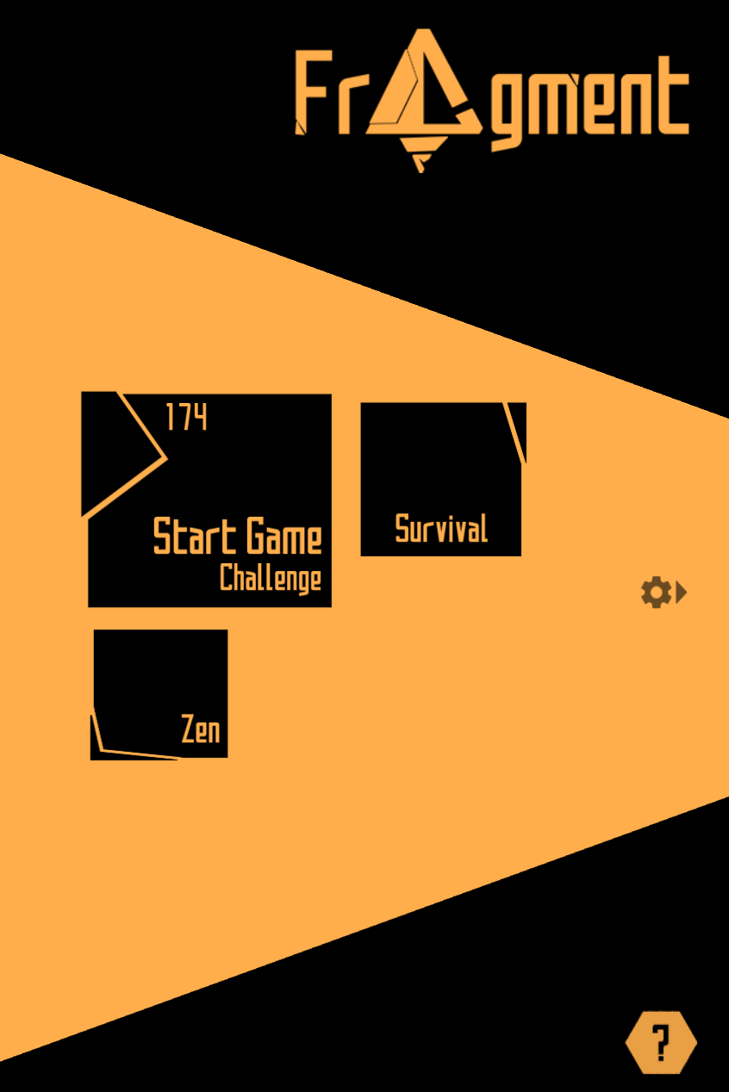
Main Menu
What was implemented
Notes:
Mostly the same, only some scalling changes
Unity example done by Rayson

Slide 5
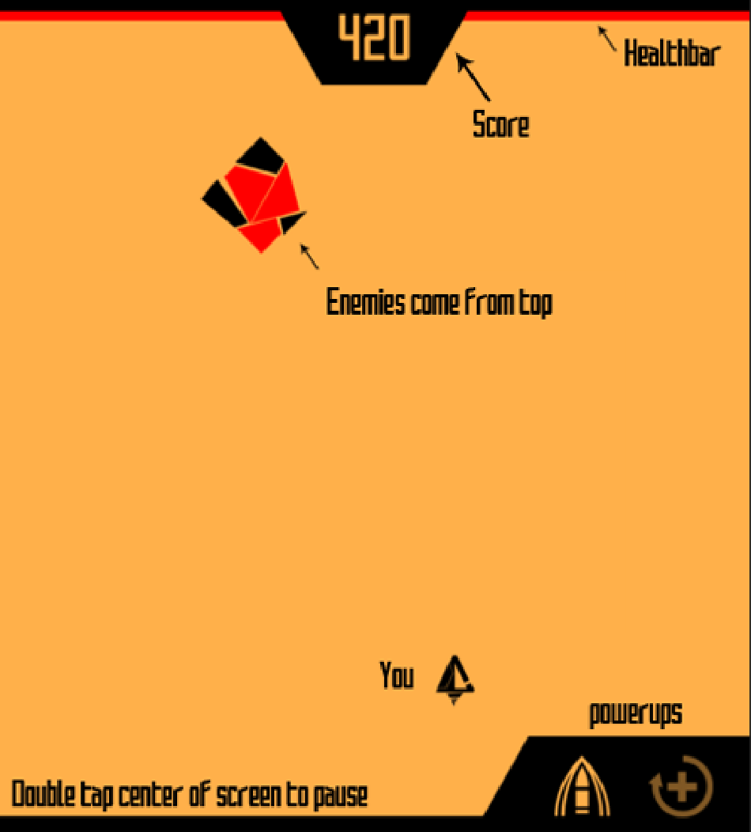


Help Screen
Notes:
WHEN HELP BUTTON IS TAPPED ON, THE ‘HELP SCREEN’ WILL ‘UNFOLD’ FROM THE HELP BUTTON.
TAPPING ANYWHERE WILL ‘FOLD’ THE HELP SCREEN BACK INTO THE HELP BUTTON.
THERE WILL BE AN ANIMATION [AS THE SHIP SHOOTS AUTOMATICALLY] TO SHOW WHAT HAPPENS WHEN YOU DESTROY THE ENEMY.
WHEN THE ANIMATION FINISHES PLAYING, THE HELP SCREEN WILL AUTOMATICALLY ‘FOLD’ BACK INT OTHE HELP BUTTON.
DESIGNED BY WENGYEW.
SCREEN TAKEN FROM GABRIEL’S SLIDE.
Unity example done by Rayson

Slide 6
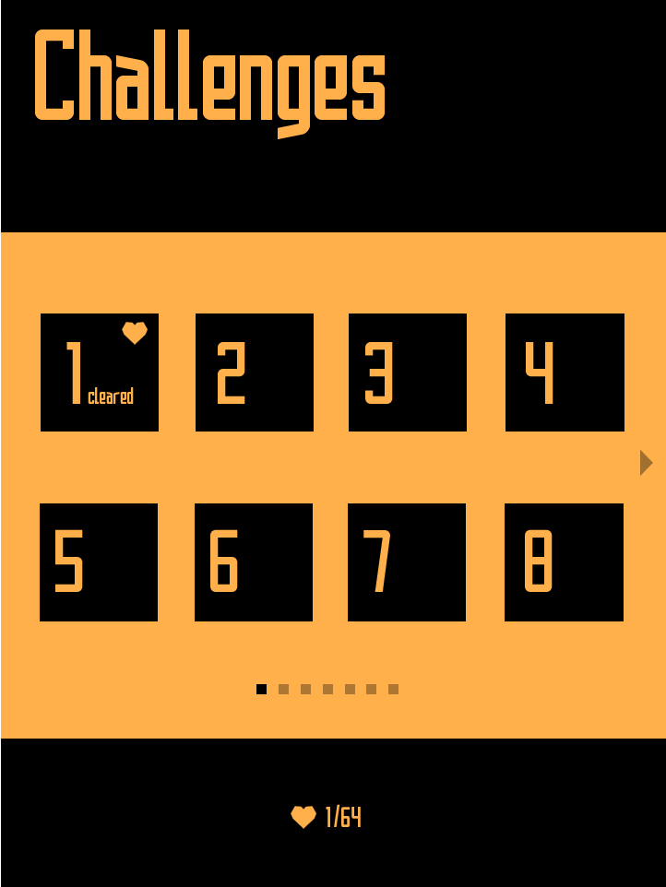

Challenge Select
Notes:
TAP ON A BOX TO START CHALLENGE ‘X’, WHERE X IS THE NUMBER IN THE BOX.
CLEARING A CHALLENGE WILL SHOW ‘CLEARED’, CLEARING A CHALLENGE WITHOUT LOSING LIFE WILL CAUSE A ‘HEART’ ICON TO APPEAR.
NUMBER OF HEARTS YOU HAVE COLLECTED SO FAR SHOWED AT THE BOTTOM.
TAP ON BACK BUTTON TO GO BACK TO MAIN MENU.
SWIPE LEFT/RIGHT TO SCROLL BETWEEN PAGES.
SMALL BOXES AT BOTTOM SHOW CURRENT PAGE, AND TOTAL NUMBER OF PAGES.
DESIGNED BY WENGYEW.
Unity example done by Weng Yew

Slide 7
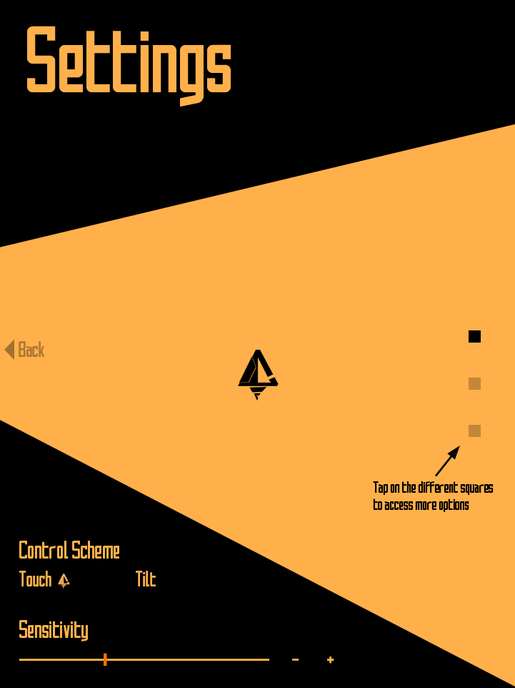
Options
Page
Spaceship
Notes:
SPACESHIP SETTINGS PAGE. THE FIRST TIME ENTERING THIS SCREEN, THE TEXT ‘TAP ON DIFF SQUARES TO ACCESS MORE OPTIONS’ WILL APPEAR.
SWIPE FROM LEFT TO RIGHT OR TAP ON BACK BUTTON TO GO BACK TO MAIN MENU.
TAP ON CONTROL SCHEME TO SWAP BETWEEN TOUCH/TILT CONTROL SCEHEME.
FOR TOUCH CONTROL SCHEME, RELATIVE ANCHOR CONTROL. (eg tap and hold down, then move relative to initial tap position)
FOR TILT CONTROL SCHEME, TILT TABLET TO MOVE.
SPACESHIP IS INTERACTIVE TO TEST YOUR SENSITIVITY/CONTROL SCHEME.
ADJUST SENSIVITITY BY DRAGGING SLIDER OR TAPPING ON - + ICON
NAVIGATE BETWEEN OPTIONS PAGE BY TAPPING ON SQUARES ON THE RIGHT.
DESIGNED BY WENGYEW.
Unity example done by Weng Yew

Slide 8
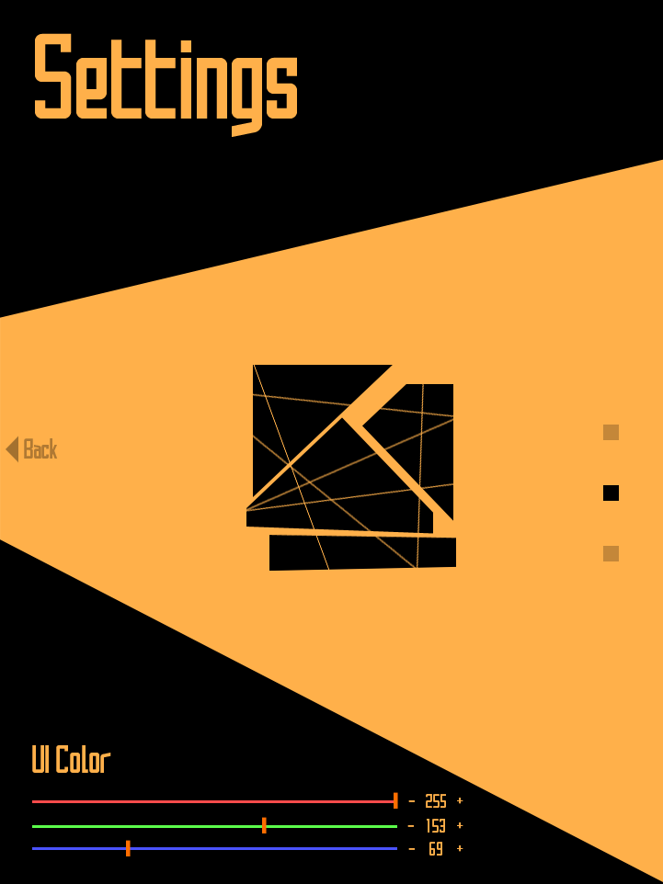
Options
Page
UI
Notes:
UI SETTINGS.
SWIPE FROM LEFT TO RIGHT OR TAP ON BACK BUTTON TO GO BACK TO MAIN MENU.
DRAG SLIDERS OR USE THE - + ICONS TO ADJUST R G B VALUES FOR THE BACKGROUND.
NAVIGATE BETWEEN OPTIONS PAGE BY TAPPING ON SQUARES ON THE RIGHT.
BOX IN MIDDLE IS DECORATIONAL.
DESIGNED BY WENGYEW.
Unity example done by Weng Yew

Slide 9
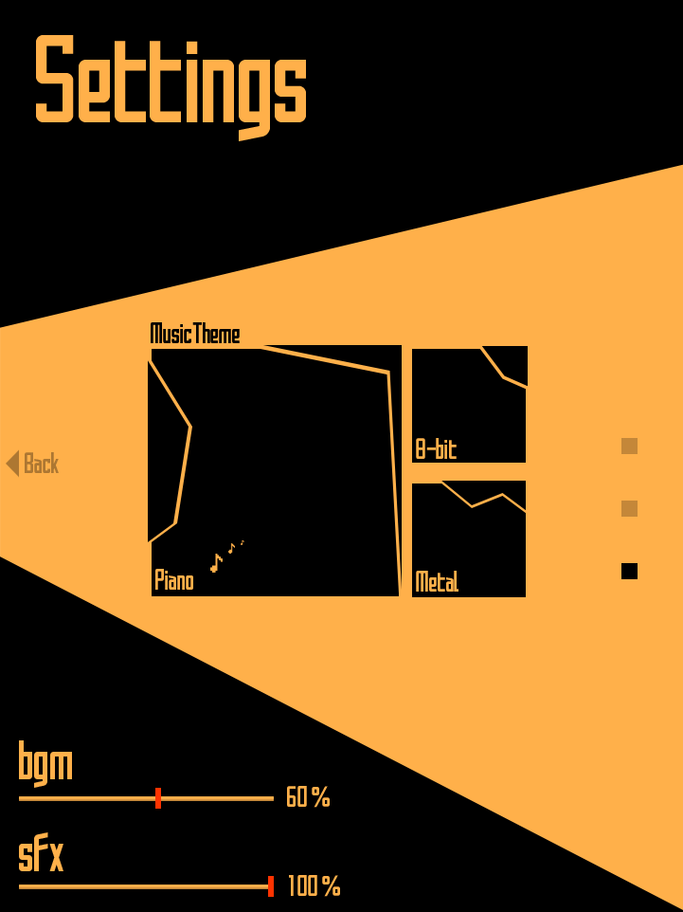
Options
Page
Sound
Notes:
SOUND SETTINGS PAGE.
SWIPE FROM LEFT TO RIGHT OR TAP ON BACK BUTTON TO GO BACK TO MAIN MENU.
TAP ON SQUARES IN MIDDLE TO SELECT RESPECTIVE MUSIC THEME.
ADJUST VOLUME OF BGM/SFX USING THE SLIDER. (no - + as not that important)
DESIGNED BY WENGYEW.
Unity example done by Weng Yew

Slide 10
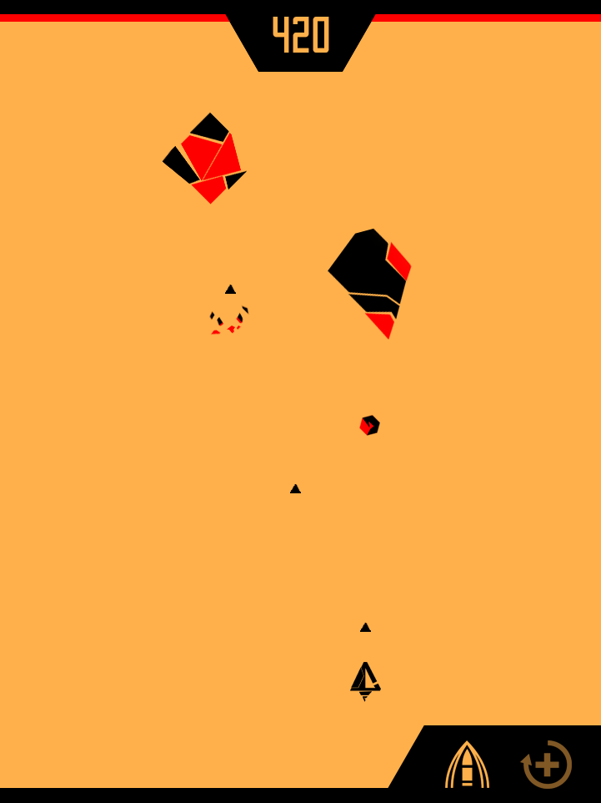
Gameplay Screen
Challenge
Notes:
UI DESIGNED TO BE CLEAN AND UNOBSTRUSIVE.
YOUR SHIP SHOOTS AUTOMATICALLY. YOU SPAWN AT BOTTOM OF THE SCREEN.
FOR CHALLENGE MODE, ENEMIES LEFT SHOWED AT BOTTOM LEFT.
POWERUPS AT BOTTOM RIGHT, WILL BE YELLOW WHEN AVAILABLE TO USE, RED WHEN IN USE, FADED WHEN UNAVAILABLE.
SCORE DISPLAYED AT TOP.
HEALTH DISPLAYED AT TOP.
ENEMIES ENTER FROM TOP OF SCREEN.
DESIGNED BY GABRIEL.
Unity example done by Gabriel

Slide 11
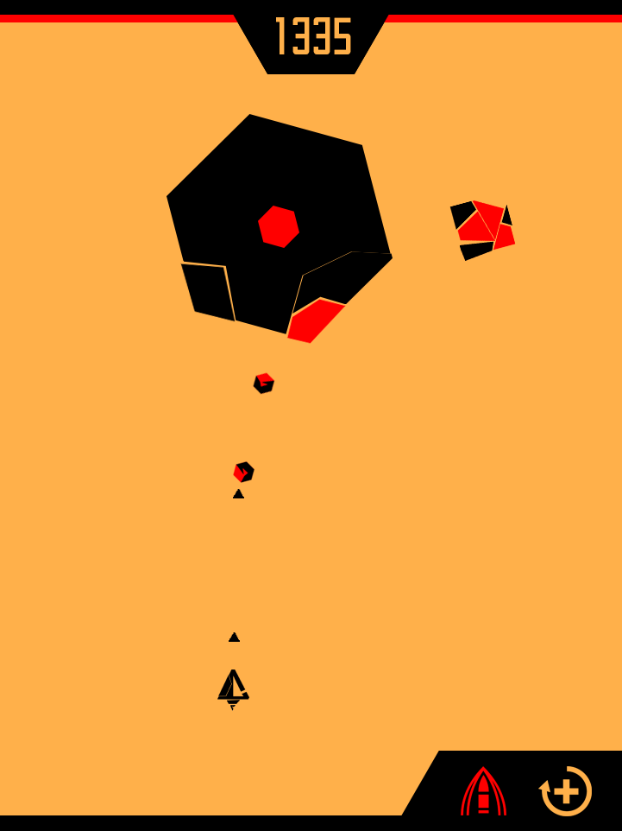
Gameplay Screen
Challenge
Notes:
UI DESIGNED TO BE CLEAN AND UNOBSTRUSIVE.
YOUR SHIP SHOOTS AUTOMATICALLY. YOU SPAWN AT BOTTOM OF THE SCREEN.
TO DEFEAT ENEMIES, YOU NEED TO DESTROY ALL RED PARTS.
FOR CHALLENGE MODE, ENEMIES LEFT SHOWED AT BOTTOM LEFT.
POWERUPS AT BOTTOM RIGHT, WILL BE YELLOW WHEN AVAILABLE TO USE, RED WHEN IN USE, FADED WHEN UNAVAILABLE.
SCORE DISPLAYED AT TOP.
HEALTH DISPLAYED AT TOP.
ENEMIES ENTER FROM TOP OF SCREEN.
DESIGNED BY GABRIEL.
Unity example done by Gabriel

Slide 12
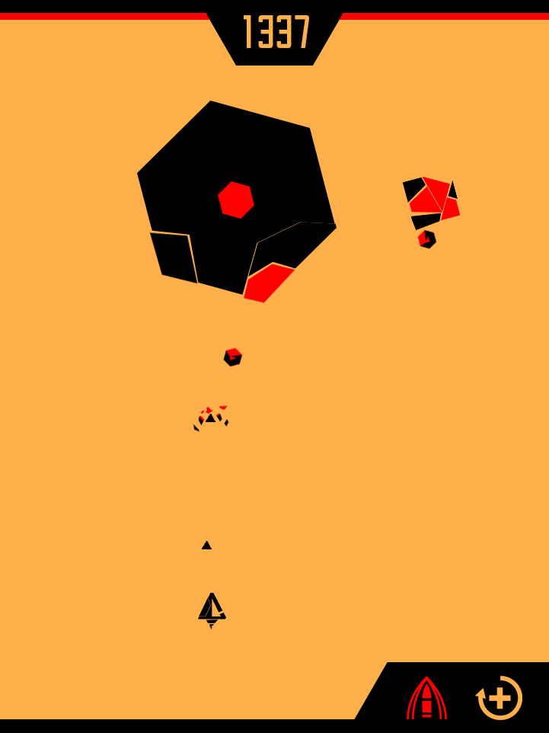
Gameplay Screen
Challenge
Notes:
UI DESIGNED TO BE CLEAN AND UNOBSTRUSIVE.
YOUR SHIP SHOOTS AUTOMATICALLY. YOU SPAWN AT BOTTOM OF THE SCREEN.
TO DEFEAT ENEMIES, YOU NEED TO DESTROY ALL RED PARTS.
WHEN YOUR BULLET HITS AN ENEMY/DESTROYS A PART, THERE WILL BE VISUAL FEEDBACK [PART DISINTEGRATING]
WHEN YOU ARE HIT, THERE WILL BE VIBRATION.
FOR CHALLENGE MODE, ENEMIES LEFT SHOWED AT BOTTOM LEFT.
POWERUPS AT BOTTOM RIGHT, WILL BE YELLOW WHEN AVAILABLE TO USE, RED WHEN IN USE, FADED WHEN UNAVAILABLE.
SCORE DISPLAYED AT TOP.
HEALTH DISPLAYED AT TOP.
ENEMIES ENTER FROM TOP OF SCREEN.
DESIGNED BY GABRIEL.
Unity example done by Gabriel

Slide 13
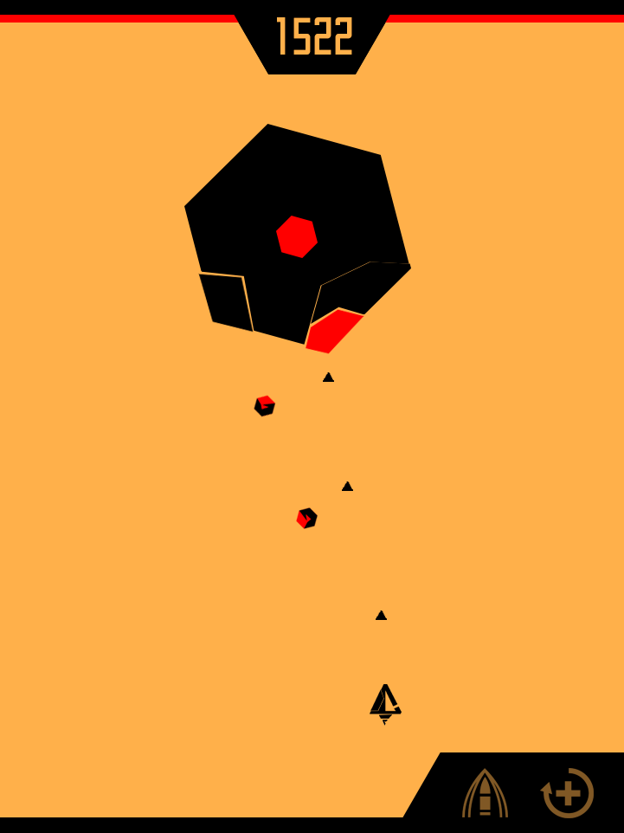
Gameplay Screen
Visual Feedback
Notes:
UI DESIGNED TO BE CLEAN AND UNOBSTRUSIVE.
YOUR SHIP SHOOTS AUTOMATICALLY. YOU SPAWN AT BOTTOM OF THE SCREEN.
TO DEFEAT ENEMIES, YOU NEED TO DESTROY ALL RED PARTS.
WHEN YOUR BULLET HITS AN ENEMY/DESTROYS A PART, THERE WILL BE VISUAL FEEDBACK [PART DISINTEGRATING]
WHEN YOU ARE HIT, THERE WILL BE VIBRATION.
FOR CHALLENGE MODE, ENEMIES LEFT SHOWED AT BOTTOM LEFT.
POWERUPS AT BOTTOM RIGHT, WILL BE YELLOW WHEN AVAILABLE TO USE, RED WHEN IN USE, FADED WHEN UNAVAILABLE.
SCORE DISPLAYED AT TOP.
HEALTH DISPLAYED AT TOP.
ENEMIES ENTER FROM TOP OF SCREEN.
DESIGNED BY GABRIEL.
Unity example done by Gabriel

Slide 14
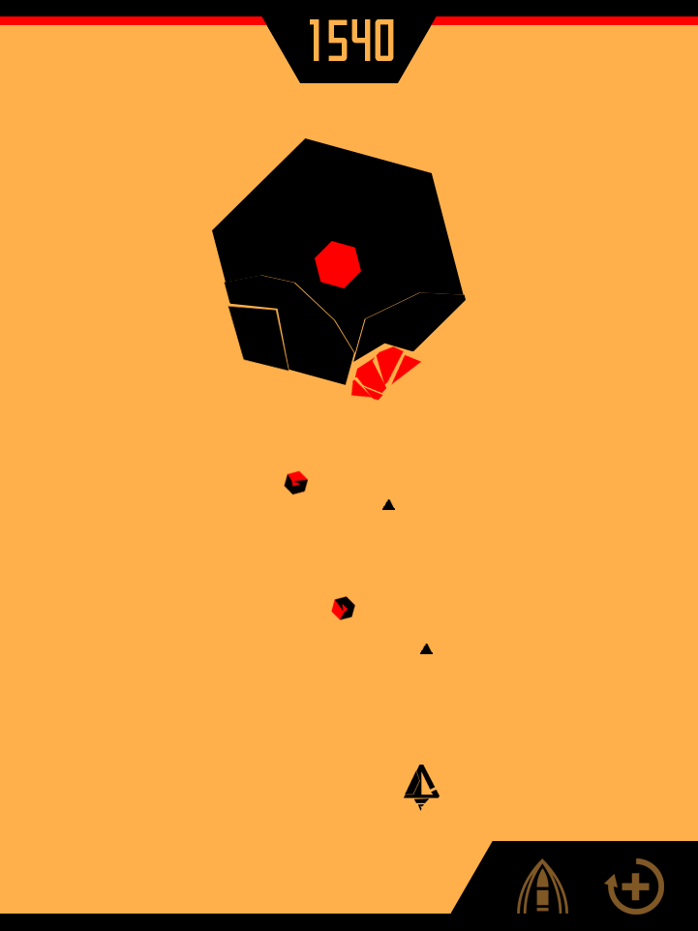
Gameplay Screen
Visual Feedback
Notes:
UI DESIGNED TO BE CLEAN AND UNOBSTRUSIVE.
YOUR SHIP SHOOTS AUTOMATICALLY. YOU SPAWN AT BOTTOM OF THE SCREEN.
TO DEFEAT ENEMIES, YOU NEED TO DESTROY ALL RED PARTS.
WHEN YOUR BULLET HITS AN ENEMY/DESTROYS A PART, THERE WILL BE VISUAL FEEDBACK [PART DISINTEGRATING]
WHEN YOU ARE HIT, THERE WILL BE VIBRATION.
FOR CHALLENGE MODE, ENEMIES LEFT SHOWED AT BOTTOM LEFT.
POWERUPS AT BOTTOM RIGHT, WILL BE YELLOW WHEN AVAILABLE TO USE, RED WHEN IN USE, FADED WHEN UNAVAILABLE.
SCORE DISPLAYED AT TOP.
HEALTH DISPLAYED AT TOP.
ENEMIES ENTER FROM TOP OF SCREEN.
DESIGNED BY GABRIEL.
Unity example done by Gabriel

Slide 15
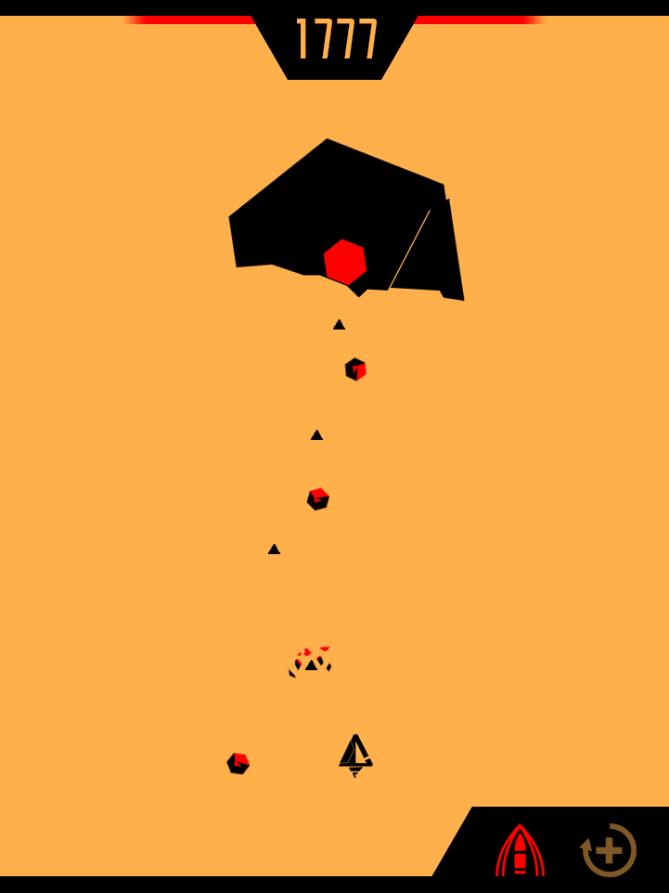
Gameplay Screen
Visual Feedback
Notes:
UI DESIGNED TO BE CLEAN AND UNOBSTRUSIVE.
YOUR SHIP SHOOTS AUTOMATICALLY. YOU SPAWN AT BOTTOM OF THE SCREEN.
TO DEFEAT ENEMIES, YOU NEED TO DESTROY ALL RED PARTS.
WHEN YOUR BULLET HITS AN ENEMY/DESTROYS A PART, THERE WILL BE VISUAL FEEDBACK [PART DISINTEGRATING]
WHEN YOU ARE HIT, THERE WILL BE VIBRATION.
FOR CHALLENGE MODE, ENEMIES LEFT SHOWED AT BOTTOM LEFT.
POWERUPS AT BOTTOM RIGHT, WILL BE YELLOW WHEN AVAILABLE TO USE, RED WHEN IN USE, FADED WHEN UNAVAILABLE.
SCORE DISPLAYED AT TOP.
HEALTH DISPLAYED AT TOP.
ENEMIES ENTER FROM TOP OF SCREEN.
DESIGNED BY GABRIEL.
Unity example done by Gabriel

Slide 16
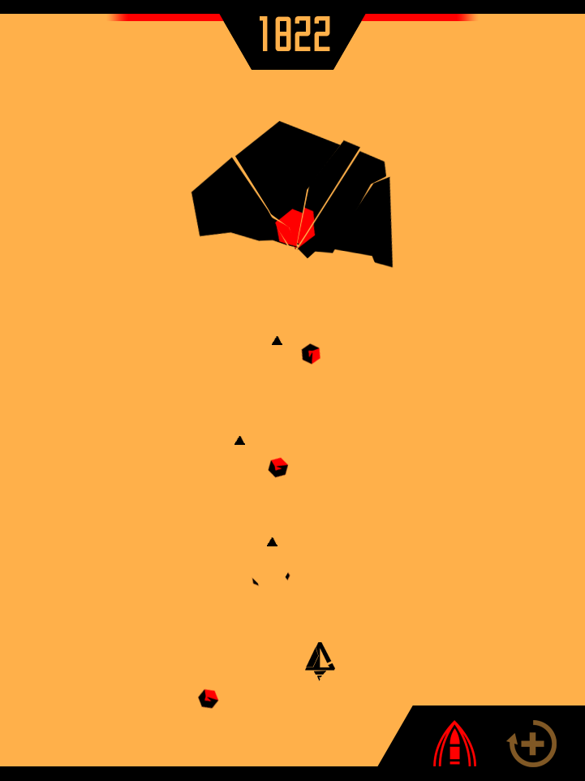
Gameplay Screen
Visual Feedback
Notes:
UI DESIGNED TO BE CLEAN AND UNOBSTRUSIVE.
YOUR SHIP SHOOTS AUTOMATICALLY. YOU SPAWN AT BOTTOM OF THE SCREEN.
TO DEFEAT ENEMIES, YOU NEED TO DESTROY ALL RED PARTS.
WHEN YOUR BULLET HITS AN ENEMY/DESTROYS A PART, THERE WILL BE VISUAL FEEDBACK [PART DISINTEGRATING]
WHEN YOU ARE HIT, THERE WILL BE VIBRATION.
FOR CHALLENGE MODE, ENEMIES LEFT SHOWED AT BOTTOM LEFT.
POWERUPS AT BOTTOM RIGHT, WILL BE YELLOW WHEN AVAILABLE TO USE, RED WHEN IN USE, FADED WHEN UNAVAILABLE.
SCORE DISPLAYED AT TOP.
HEALTH DISPLAYED AT TOP.
ENEMIES ENTER FROM TOP OF SCREEN.
DESIGNED BY GABRIEL.
Unity example done by Gabriel

Slide 17
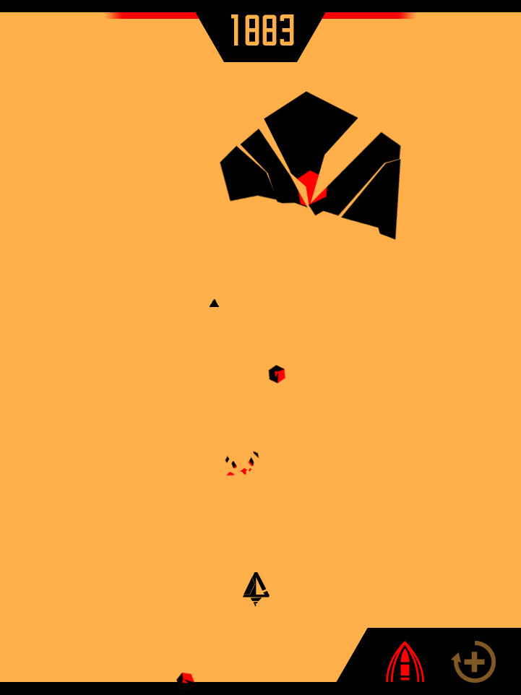
Gameplay Screen
Visual Feedback
Notes:
UI DESIGNED TO BE CLEAN AND UNOBSTRUSIVE.
YOUR SHIP SHOOTS AUTOMATICALLY. YOU SPAWN AT BOTTOM OF THE SCREEN.
TO DEFEAT ENEMIES, YOU NEED TO DESTROY ALL RED PARTS.
WHEN YOUR BULLET HITS AN ENEMY/DESTROYS A PART, THERE WILL BE VISUAL FEEDBACK [PART DISINTEGRATING]
WHEN YOU ARE HIT, THERE WILL BE VIBRATION.
FOR CHALLENGE MODE, ENEMIES LEFT SHOWED AT BOTTOM LEFT.
POWERUPS AT BOTTOM RIGHT, WILL BE YELLOW WHEN AVAILABLE TO USE, RED WHEN IN USE, FADED WHEN UNAVAILABLE.
SCORE DISPLAYED AT TOP.
HEALTH DISPLAYED AT TOP.
ENEMIES ENTER FROM TOP OF SCREEN.
DESIGNED BY GABRIEL.
Unity example done by Gabriel

Slide 18
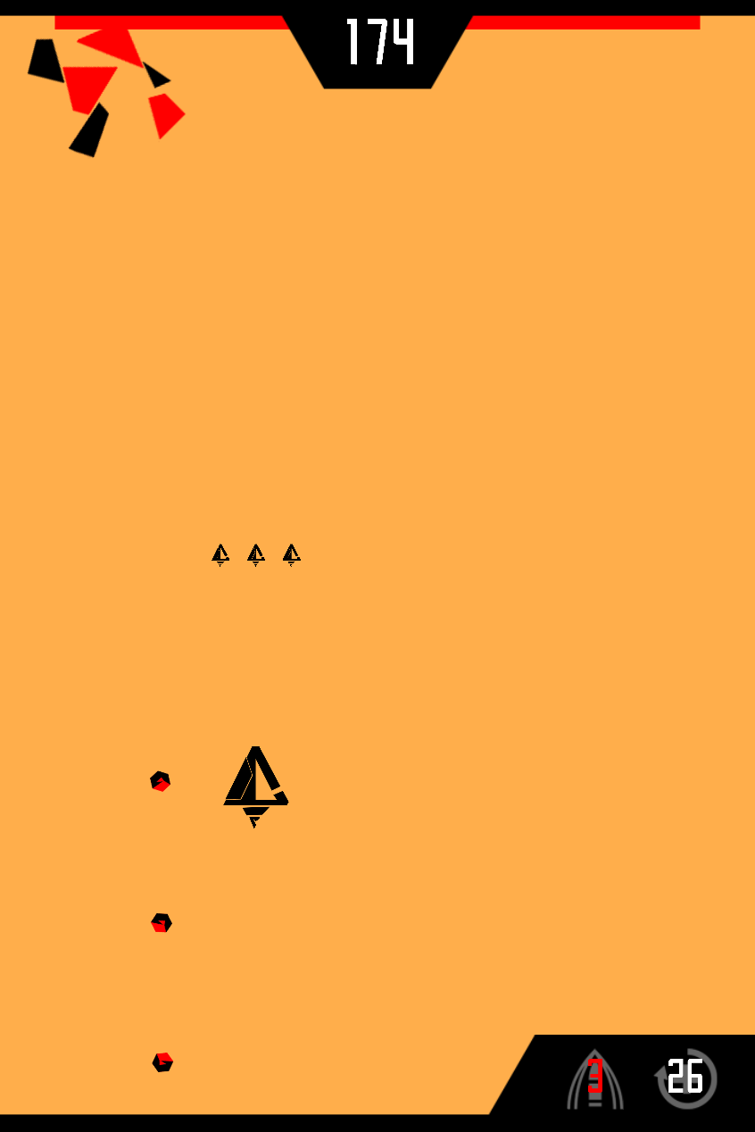
Gameplay Screen
What was implemented
Notes:
Highscore is now white in colour instead of the game colour to make it more visible.
When abilities are charging, you are able to see white numbers on the button to indicate the amount of time before the ability can be used again, when it is able to be used, the button will be white without any text.
When an ability is being used, there will be a red number showing the amount of time left before the ability runs out.
Otherwise, the UI is mostly the same, 1 change being the different scaling for all the screens due to the slightly changed aspect ratio
Unity example done by Gabriel

Slide 19
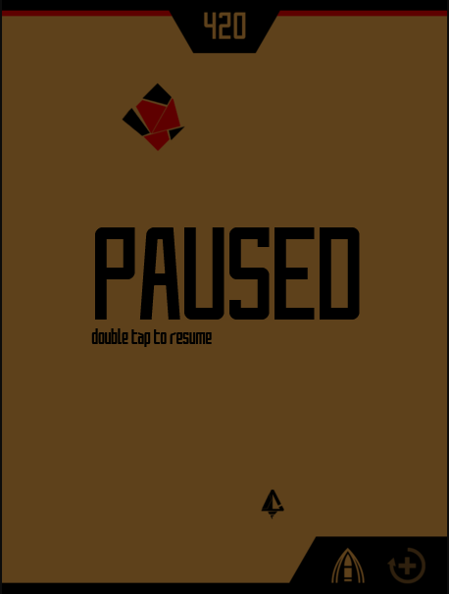


Pause
Original Plan
Notes:
WHEN PAUSED, GAMEPLAY SCREEN IS DIMMED AND HIDDEN, AND ALL ACTIVITY IS HALTED.
DOUBLE TAP ON THE SCREEN TO RESUME.
HOLD THE QUIT BUTTON TO QUIT. [SLIDE 18]
DESIGNED BY WENGYEW.
Unity example done by Gabriel

Slide 20
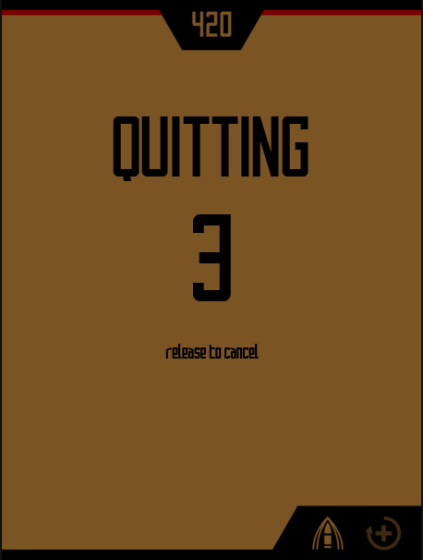
Quit
Original Plan
Notes:
WHEN QUITTING, RELEASING WILL BRING YOU BACK TO PAUSE SCREEN [SLIDE 17]
DESIGNED BY WENGYEW.
Unity example done by Gabriel

Slide 21
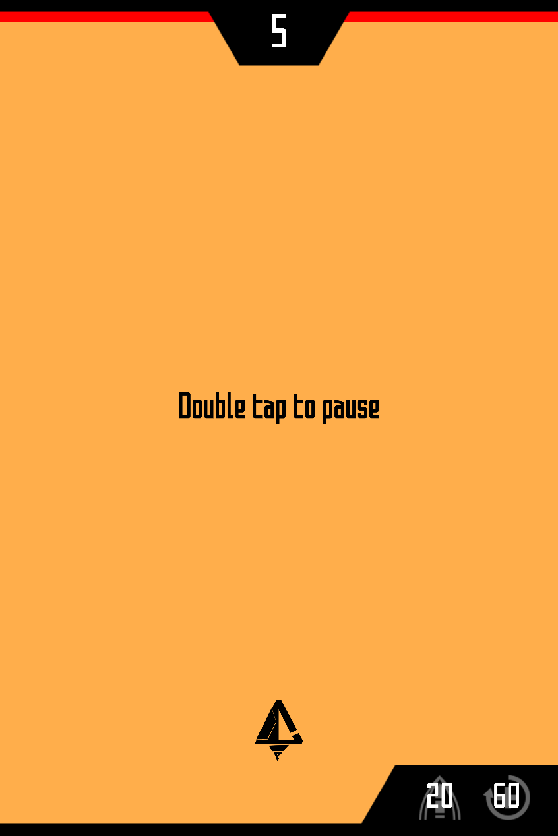
Pause
What was implemented
Notes:
Now, at the start of the game, an instruction is shown that to pause the game, you have to double tap the screen
Unity example done by Gabriel

Slide 22
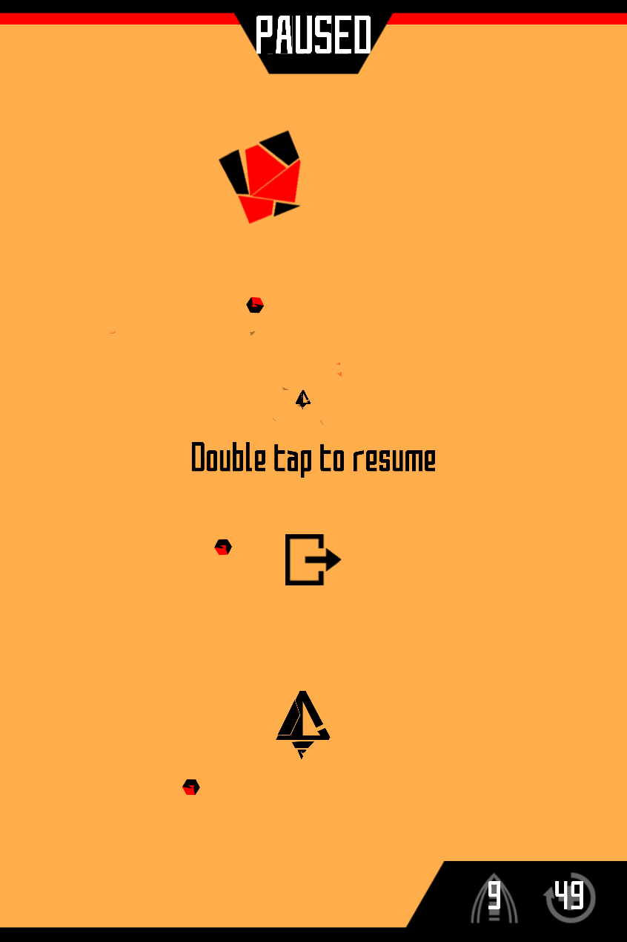
Pause
What was implemented
Notes:
And after double tapping, the game will pause, with the exit button and some text will fading in smoothly.
Double tap to resume will be shown so that the user will know how to resume the game.
The exit button is placed very close to the text so that it is very visible
Unity example done by Gabriel

Slide 23
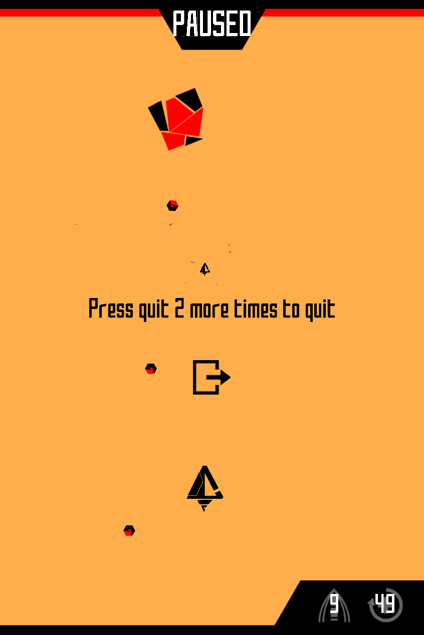
Pause
What was implemented
Notes:
And now when pressing the exit button on the pause menu, it will show that you have to press the button 2 more times to quit, if you tap somewhere else the exit will be cancelled.
This is to prevent accidentally quitting the game.
Unity example done by Gabriel

Slide 24
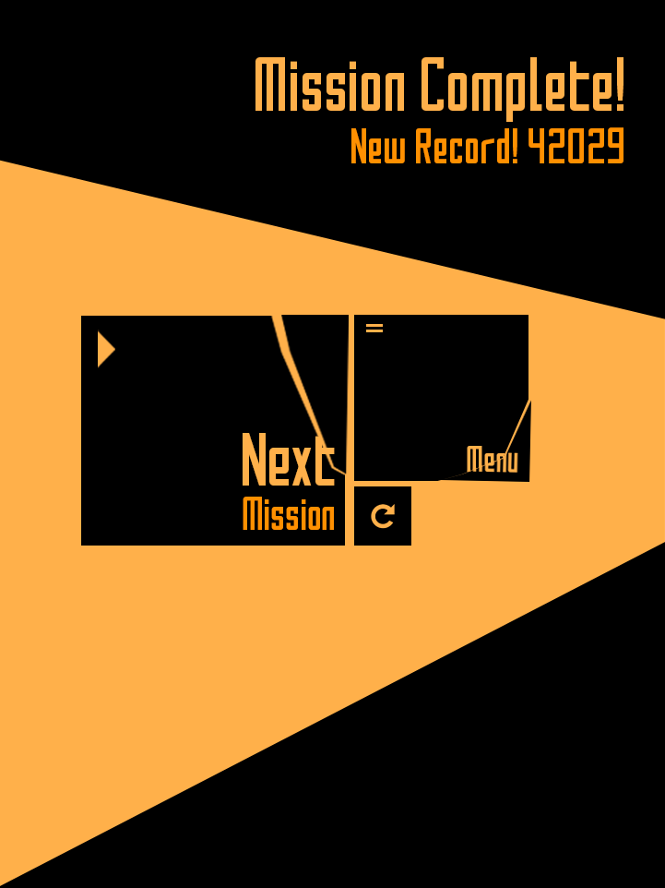
End Game
Mission Complete
Notes:
SIZE OF THE BUTTON IS BASED ON WHAT WE THINK THE USER IS MORE LIKELY TO CLICK ON.
SCORE WILL BE SHOWN FOR MISSION ON THE TOP RIGHT.
IF NOT A NEW RECORD, HIGHEST RECORD WILL BE SHOWN.
TAP ON THE ARROW TO RESTART THE MISSION.
TAP ON THE MENU SQUARE TO GO BACK TO THE MAIN MENU
TAP ON THE NEXT MISSION SQUARE TO GO TO THE NEXT MISSION
HEART SHAPE WILL APPEAR IF MISSION IS COMPLETED WITHOUT TAKING DAMAGE.
DESIGNED BY GABRIEL.
Unity example done by Rayson, score implementation by Gabriel

Slide 25
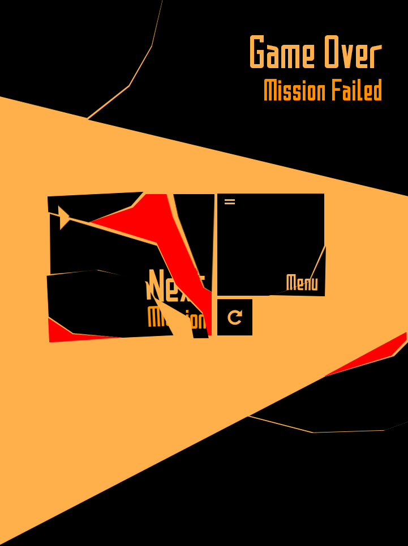
End Game
Mission Fail
Notes:
SIZE OF THE BUTTON IS BASED ON WHAT WE THINK THE USER IS MORE LIKELY TO CLICK ON.
SCORE REPLACED BY ‘MISSION FAILED’
TAP ON THE ARROW TO RESTART THE MISSION.
TAP ON THE MENU SQUARE TO GO BACK TO THE MAIN MENU
DESIGNED BY GABRIEL.
Unity example done by Rayson, score implementation by Gabriel

Slide 26
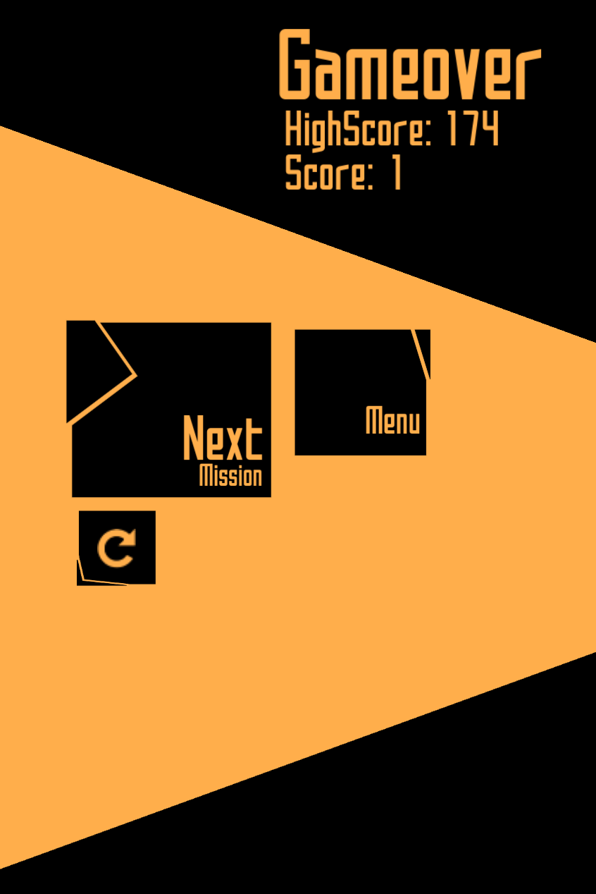
End Game
What was implemented
Notes:
The UI setup now is very similar to the main menu. The next mission button will bring to the next mission while the restart button restarts the mission to be done again.
If the menu button is pushed the ui buttons and text will fly out, to be replaced with the menu screen
Unity example done by Rayson, score implementation by Gabriel

Slide 27
Menu Flow
Game Start
Colour
Splash Screen
Sensitivity
Controls
Main Menu
Help
Options
Challenge
Zen
Survival
Level Select
PLAY!
Paused
End Screen
Confirmation
Back to main menu
Notes:
Only change to the actual menu is that when you quit from the pause menu, it will go to the end screen instead of the main menu, so that the player still can view his score.

Slide 28
Task Breakdown
Notes:
WE ARE BEST TEAM.
TEAMWORK 11/9.
EVERYTHING DISCUSSED TOGETHER.
BUT SCREENS DONE SEPARATELY, THEN CONSULTED!
Splash - Rayson;
Menu Screen - Rayson;
Help Screen - Rayson;
Challenge Screen - Weng Yew;
All Options - Weng Yew;
Gameplay - Gabriel;
Pause - Gabriel;
End Game - Rayson(mostly) & Gabriel

Slide 29
Technical Challenges
Notes:
Rendering order using the sorting layer

Slide 30
Q&A
Notes:
The end!

